Slide 1

Requirement Analysis & Design
I-CARE
November 19th 2021

Slide 2




Our team
Group # 6
Farimah Anvari
Mansoure Ebrahimi
Sajedeh Firouzizadeh
Razieh Ahmadi
1

Slide 3
Revenue Model
01
2

Slide 4
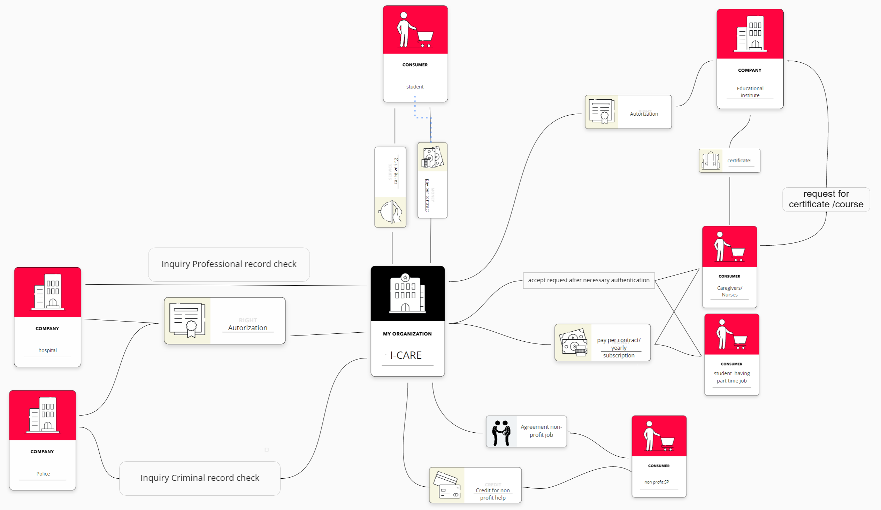
​
Revenue Model
3

Slide 5
System Technologies
02
4

Slide 6





Applications
Server & Data Base
React-Native
Redis
Neo4j
React
Java
5

Slide 7
System Architecture
03
6

Slide 8
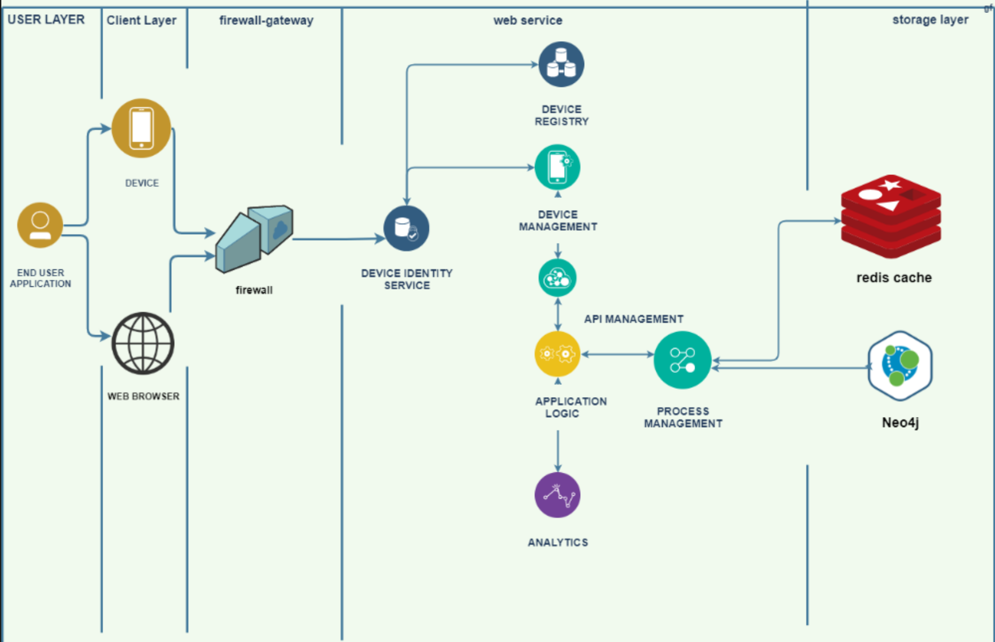
4

Slide 9
Project Workflow
04
8

Slide 10
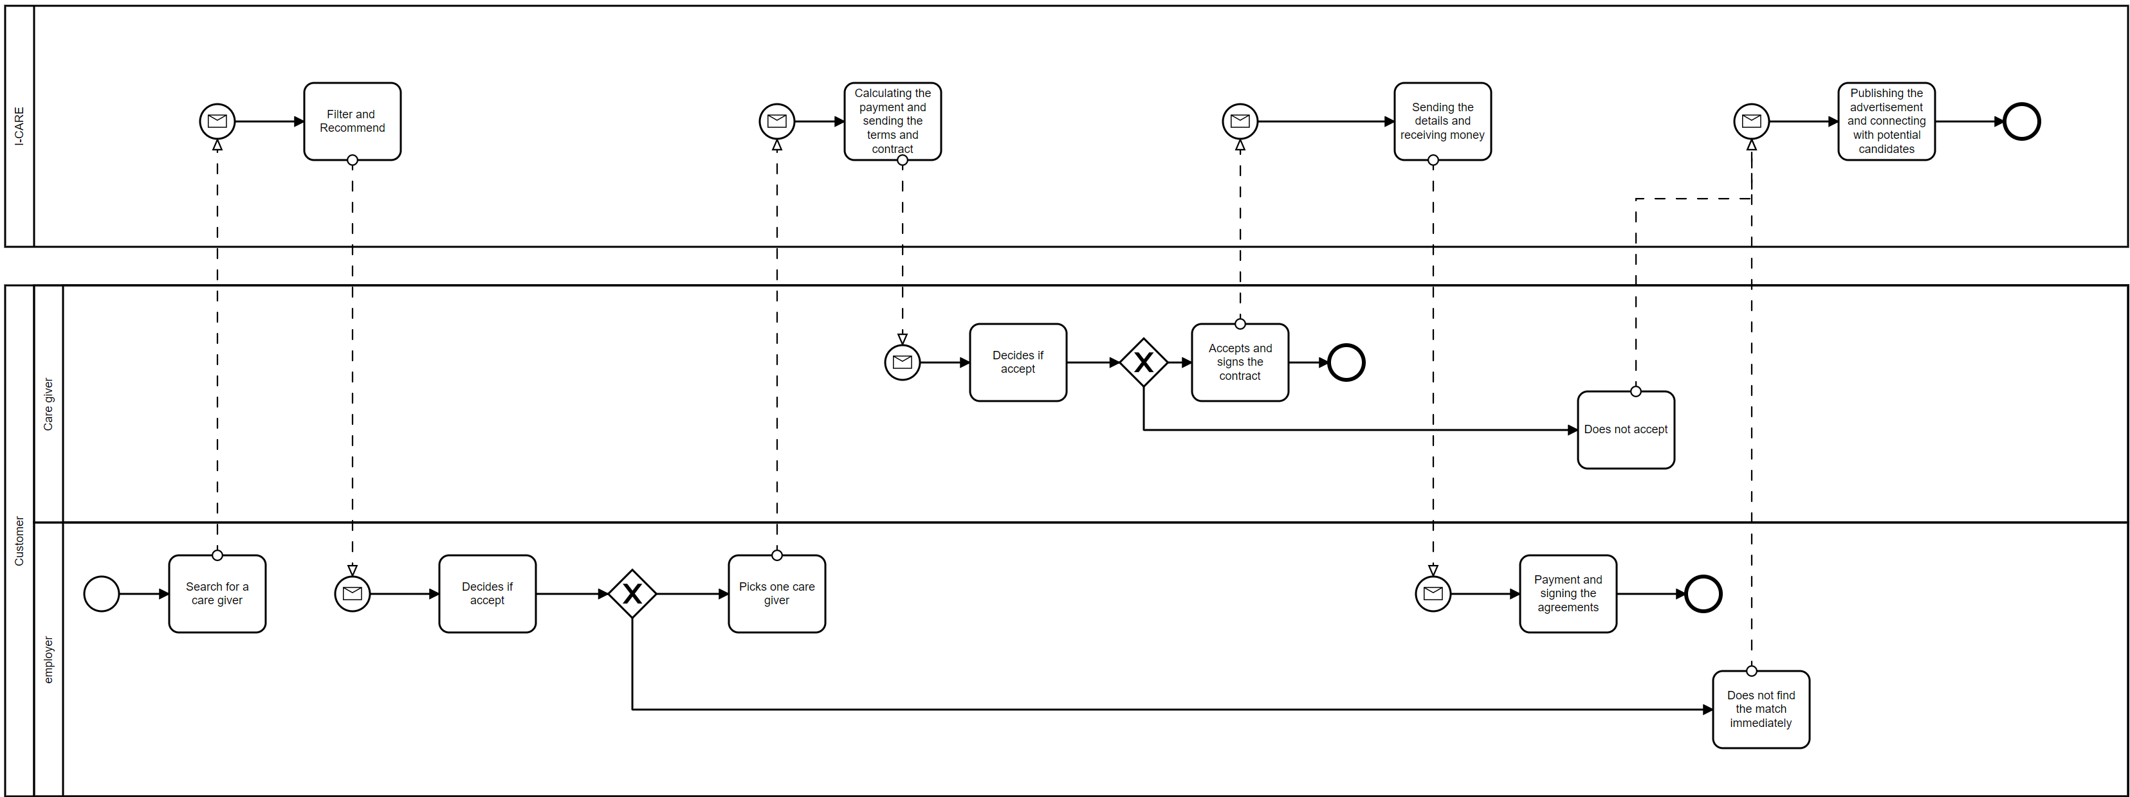
9

Slide 11
Project Workplan
05
10

Slide 12
Idea
Brainstorm
Concept selection
Research
Risk analysis
Selecting technology
Implement
UI design
Marketing
Validate idea
Database design
Test
Finding service providers
Email pre-launch list
Marketing campaigns
11

Slide 13
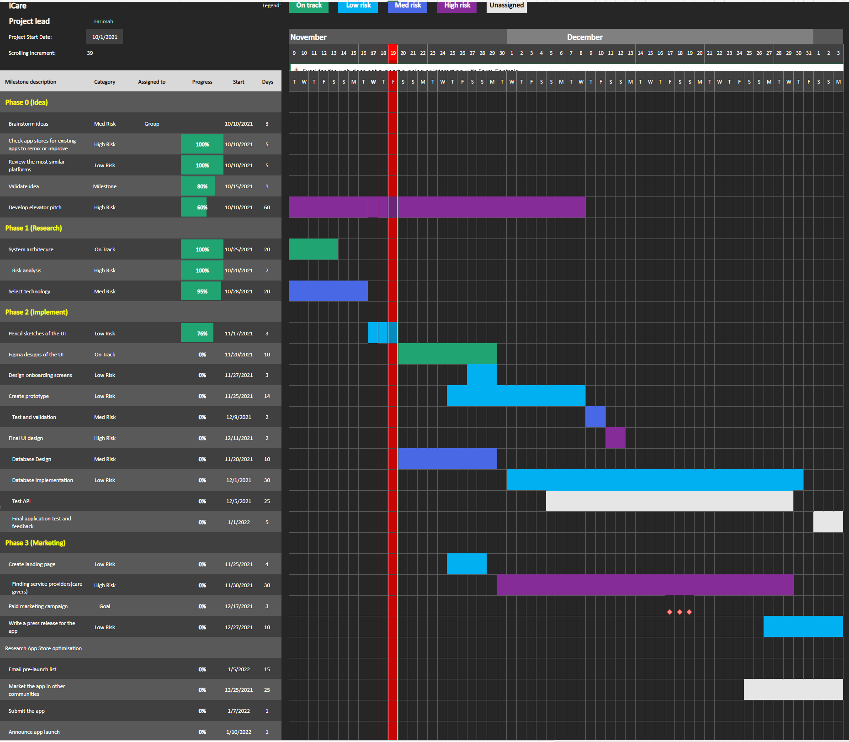
TODAY
12

Slide 14
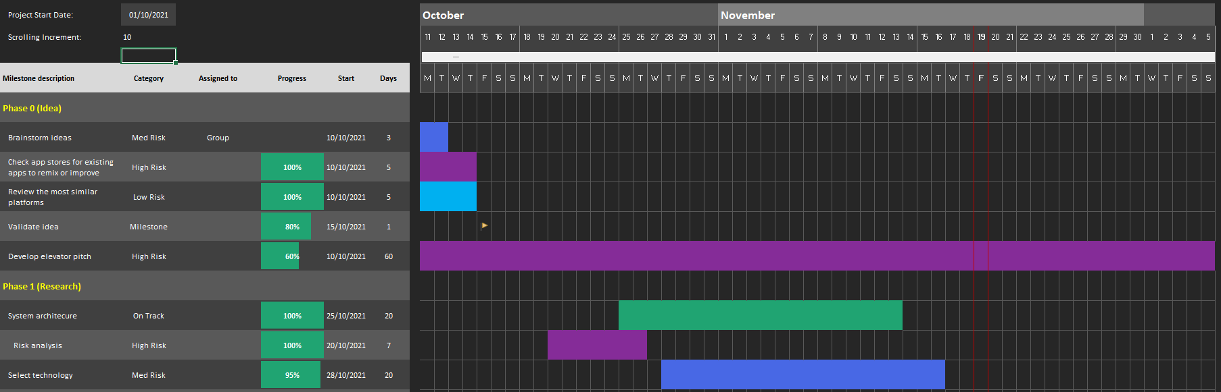
Phase0 & Phase1

Slide 15
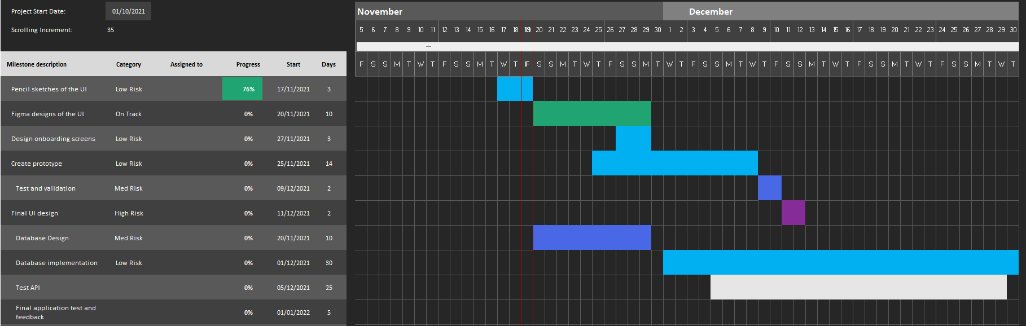
Phase 2

Slide 16
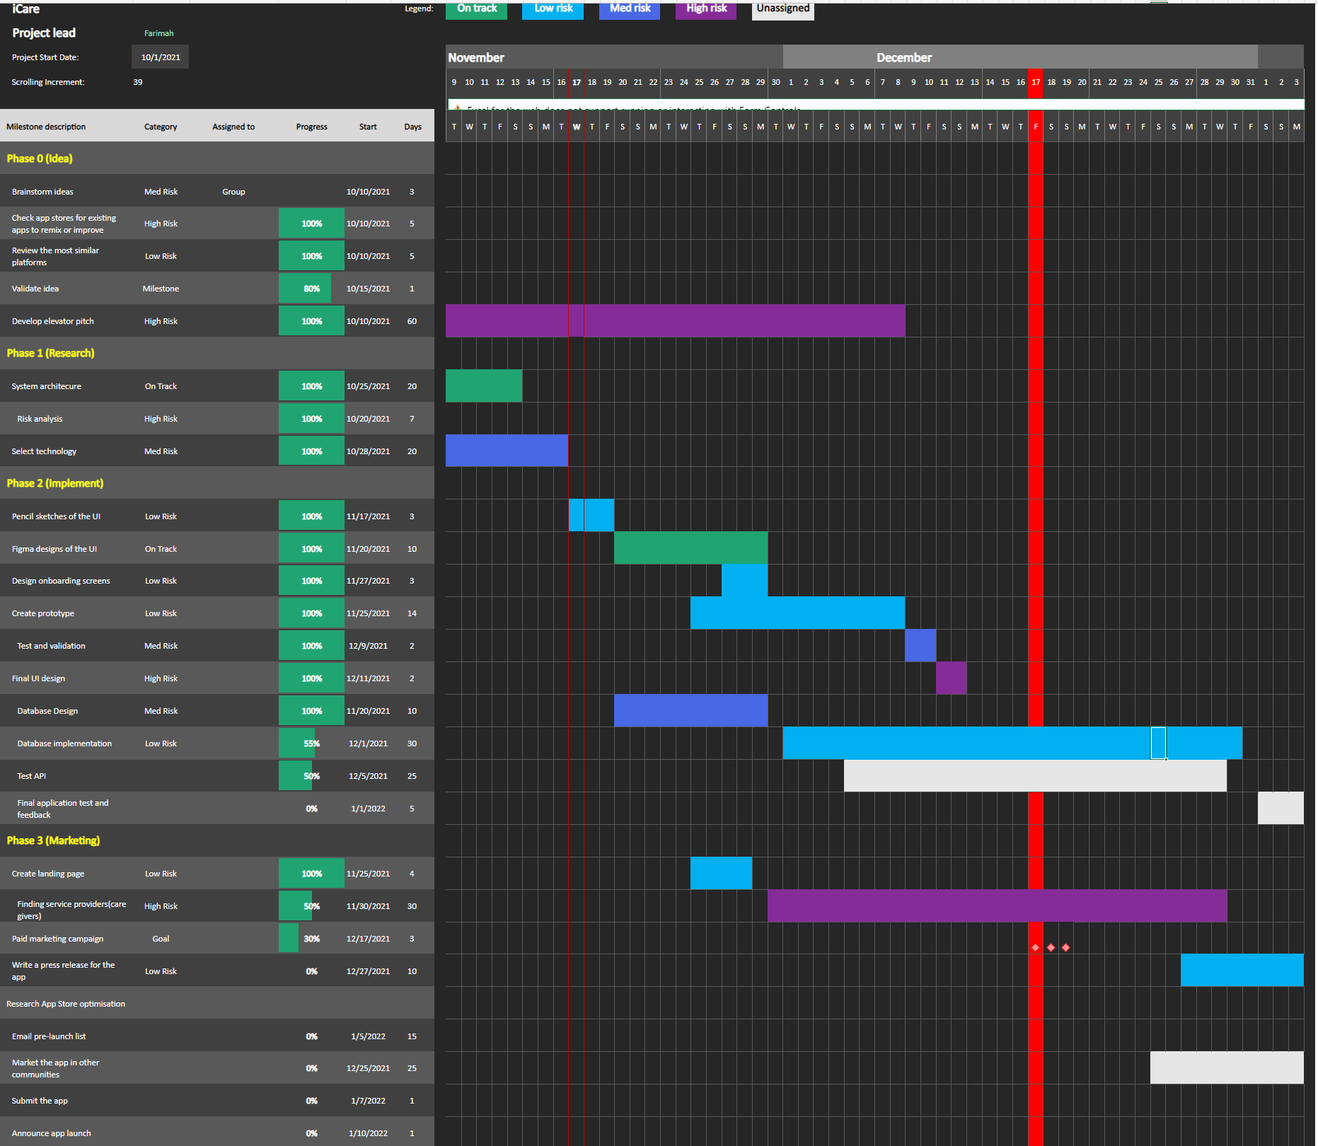
15

Slide 17
Strength
Trusted and well trained care givers
Fast and smooth process of finding a care giver
Weakness
Inaccessible to a large consumer audience
Fewer range of options at the beginning
Opportunities
The price of switching to other platforms is high
Majority of the population is getting old and needs a caregiver
Threats
Not knowing the correct price for our service at first
Easy to use UI
Emerging competitors (Germany)
Underserved market in Italy
Safety and trust
Feedback system
Picky employers and limited budget they are willing to spend
16

Slide 18
THANKS

